Slide 1

Heart Care
Heart Attack Possibility
Shahajadi Sadia Afsana
ID: 180104138
Group: C2

Slide 2
01
02
03
Introduction
Literature Reviews
Data Collection & Processing
04
05
06
Methodology
Experiments and Results
Future Work and Conclusion

Slide 3
01
INTRODUCTION

Slide 4
The heart seems to be a very complicated organ in the human body.If some part of the heart has been seriously damaged, the remaining part of the heart will remain functioning. But as a result of the injury, the heart can be weakened and unable to pump as much blood as normal.With timely detection of those injuries can save life.Various types machine learning algorithm including random forest, MLP, KNN, and Adaboost can be used for this detection.
My attempt is to detect that possibility of heart attract using Machine Learning approach in this study.This paper determines the optimum algorithm and illustrates the confusion matrices, features, and ROC curve. It is clear from this research that KNN is the best model, with an accuracy of roughly 82%.
01

Slide 5
02
Literature Reviews

Slide 6

Cardiovascular disease had become the leading cause of death in the United States by 1940[1]. When President Franklin D. Roosevelt died in 1945 of hypertensive heart disease,Americans became interested in heart disease research [2]. The Framingham Heart Study was founded in the United States in 1948 to study heart disease and its various risk factors[3]. Since then, there has been continuous research on heart failure and its various risk factors, with the goal of better preventing it with modern technology. In his paper, Fizar Ahmed [4] explained the architecture of heart attack rates and used the IoT concept to predict future heart attack patients. He also used one of the most popular machine learning algorithms, kNN (k Nearest Neighbour), to complete his work and achieve better accuracy.Prince Kansal et al. [5] focused on how to predict heart disease early using various data mining techniques, and they used nearly four machine learning algorithms. They used age,gender, blood pressure, and blood sugar levels in their dataset. They got better results from the decision tree. Manually diagnosing heart disease, as Asha Rajkumar [2] points out, takes a long time and requires the assistance of experts. They were particularly interested in her paper on fast diagnosis of heart disease using data mining techniques. Three algorithms and tanagra tools were used. The Naive Bayes algorithm took 609ms to diagnose the heart disease.
02

Slide 7
03
Data Collection & Processing

Slide 8
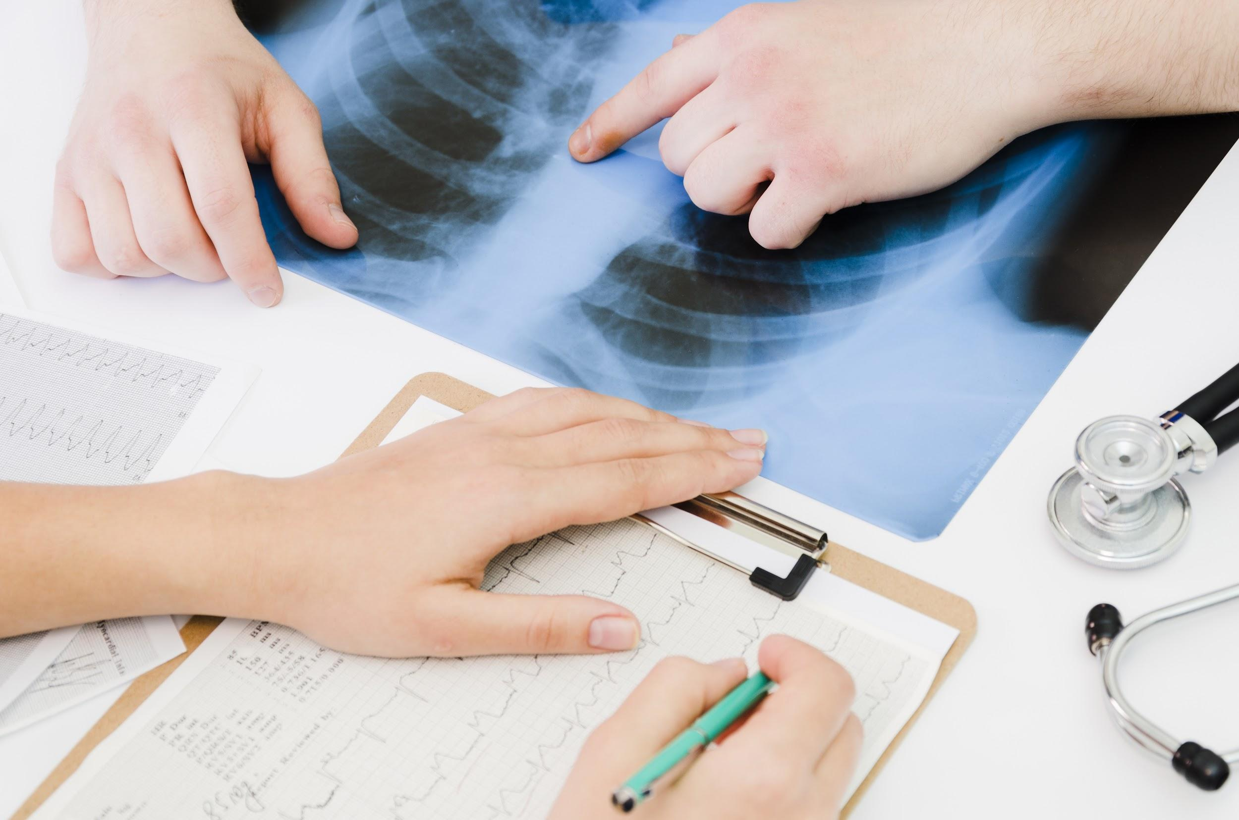
Dataset Overview
For datasets, I have used dataset from Heart Disease Data Set of UCI Machine Learning Repository [6]. This database contains 76 attributes, but here I used only 14 of them.attributes are :
1. Age
2. Sex
3. Chest Pain Type
4. Resting Blood Pressure (in mm)
5. Serum Cholesterol in mg/dl
6. Fasting Blood Sugar > 120 mg/dl
7. Resting Electrocardiographic Results
8. Maximum Heart Rate Achieved
9. Exercise Induced Angina
10. ST depression induced by exercise relative to rest
11. The Slope of the Peak Exercise ST Segment
12. Number of Major Vessels (0-3) Colored by Fluoroscopy
13. Thal
14. Diagnosis of Heart Disease (Angiographic Disease Status)
03

Slide 9
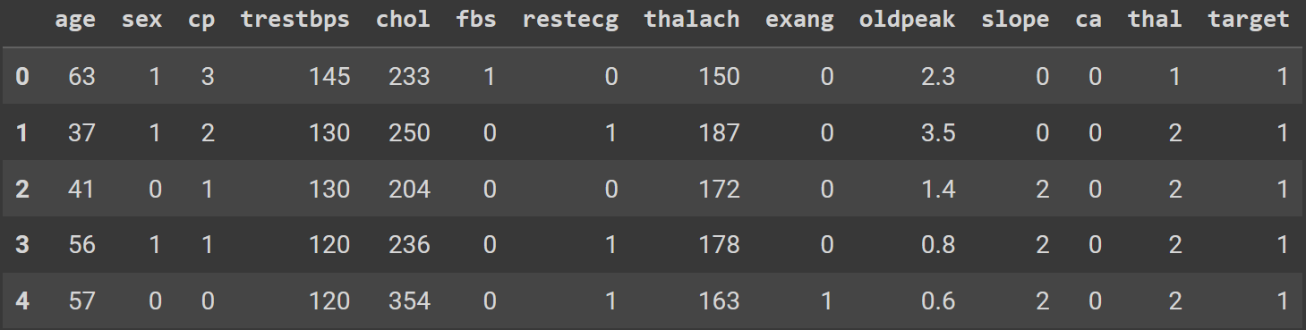
Data sample and Distribution
Sample Dataset
Distribution
 | 0 Labeled (Less Chance) | 1 Labeled (More Chance
Train.csv = 242 | 110 | 132
Test.csv = 61 | 28 | 33
Total = 303
03

Slide 10

Data Splitting
I divided the final data for training and testing in an 8:2 ratio. 80% of the data for training, while 20% were set aside for testing.
Total Data | Train Data | Test Data
303 | 242 | 61
100% data | 80% data | 20% data
Data Splitting
03

Slide 11
04
Methodology

Slide 12
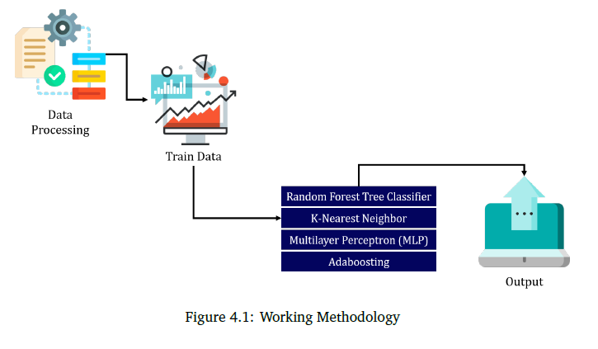
Methodology
04

Slide 13
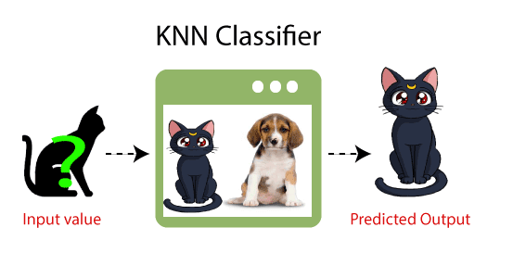
K-Nearest Neighbours
Here is an image of a creature that looks similar to cat and dog, but we want to know either it is a cat or dog. So for this identification, we can use the KNN algorithm, as it works on a similarity measure. Our KNN model will find the similar features of the new data set to the cats and dogs images and based on the most similar features it will put it in either cat or dog category.
04

Slide 14
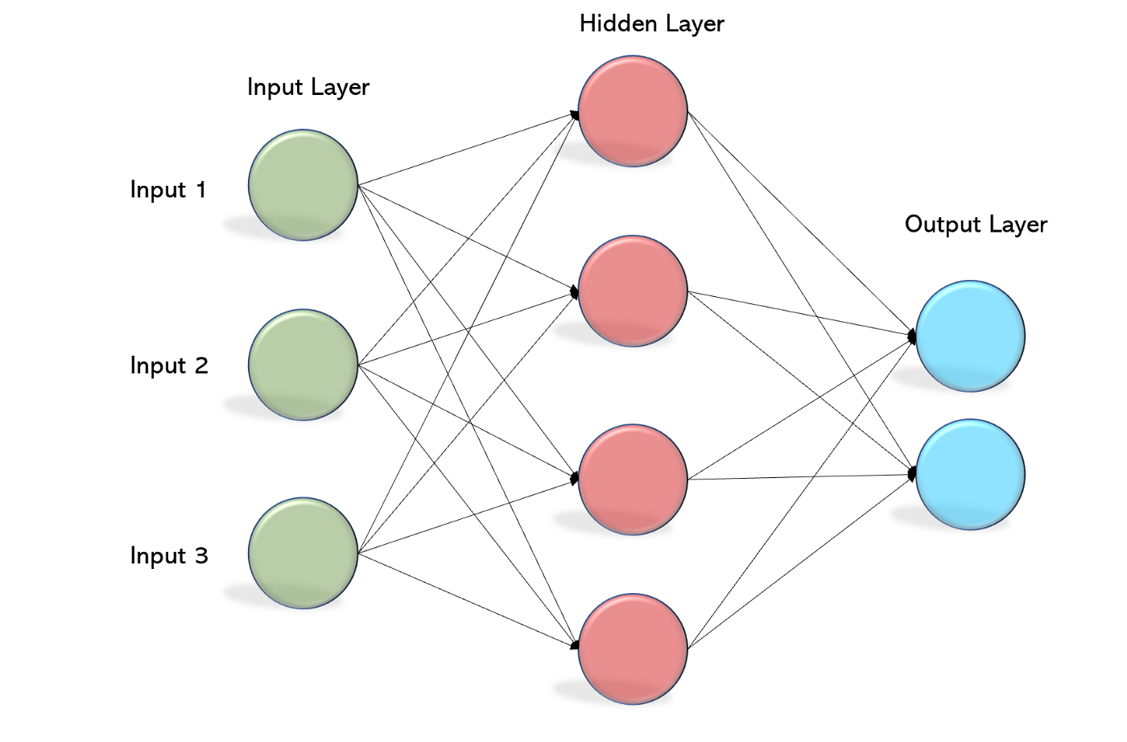
Multi layer Perceptron (MLP)
A Multilayer Perceptron has input and output layers, and one or more hidden layers with many neurons stacked together. And while in the Perceptron the neuron must have an activation function that imposes a threshold, like ReLU or sigmoid, neurons in a Multilayer Perceptron can use any arbitrary activation function.
04

Slide 15
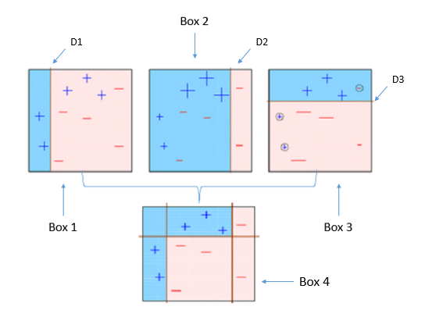
Adaboosting
AdaBoost also called Adaptive Boosting is a technique in Machine Learning used as an Ensemble Method.here the weak learners are produced parallelly during the training phase. The performance of the model can be increased by parallelly training a number of weak learners on data sets.All weak learners make a strong output together.
04

Slide 16
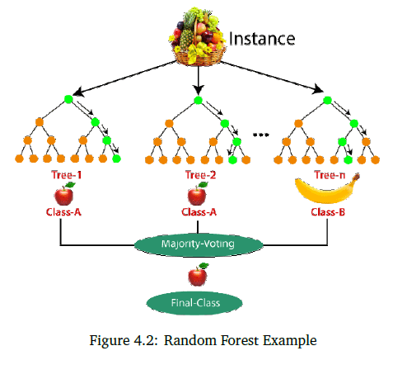
Random Forest Tree Classifier
N samples are drawn from a fruit basket, and an individual decision tree is built for each sample. The final result is determined by majority voting.Here, the majority decision tree produces an apple rather than a banana, so the final output is an apple.
04

Slide 17
05
Experiments and Results

Slide 18
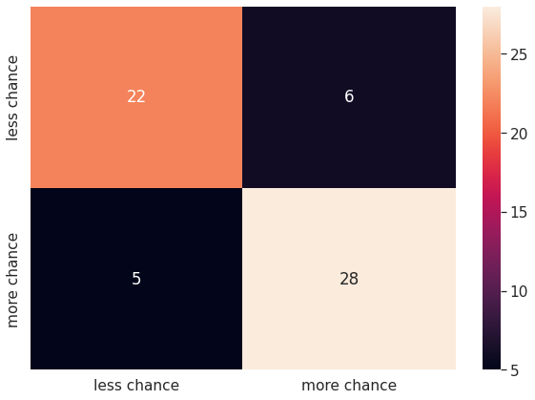
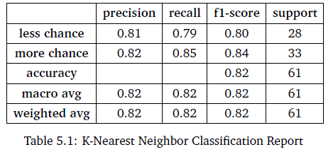
KNN
Experimental Results
Confusion Matrix
Train Average Accuracy is 82.21%
05

Slide 19
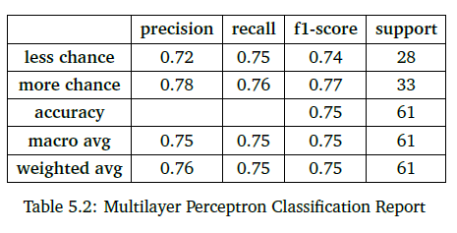

MLP
Experimental Results
Confusion Matrix
Train Average Accuracy is 80.97%
05

Slide 20
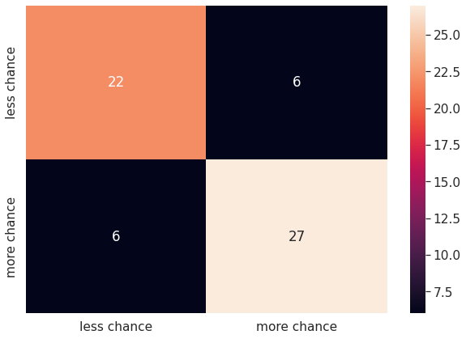
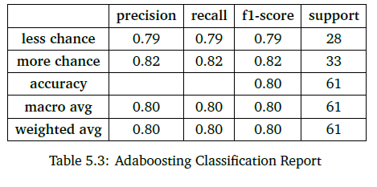
AdaBoosting
Experimental Results
Confusion Matrix
Train Average Accuracy is 82.63%
05

Slide 21
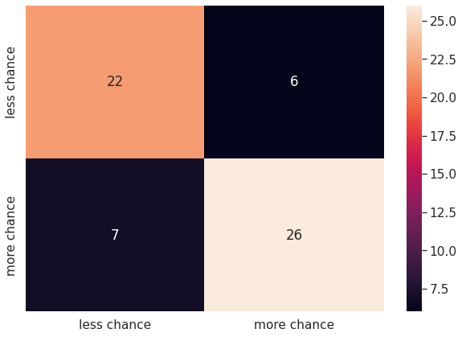
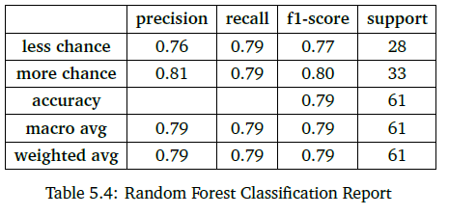
RF
Experimental Results
Confusion Matrix
Train Average Accuracy is 84.68%
05

Slide 22
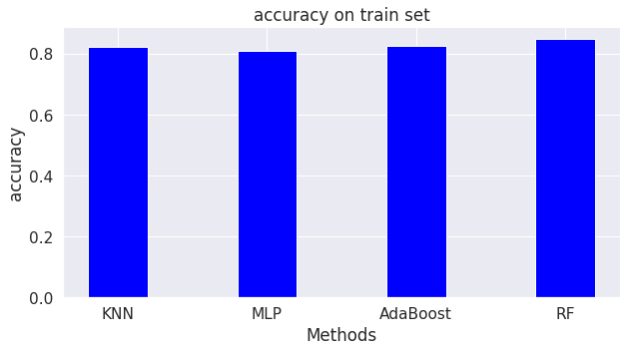
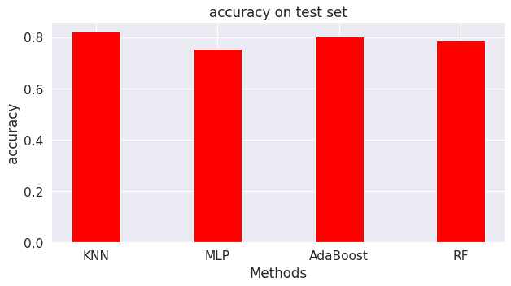
BAR CHART
Accuracy Bar chart for train set
Accuracy Bar chart for test set
05

Slide 23
Accuracy Comparison of models
KNN
MLP
AdaBoost
RF
MODELS
TRAINING ACC-82.2%
TESTING ACC- 82%
TRAINING ACC-81%
TESTING ACC- 75.4%
TRAINING ACC-82.6%
TESTING ACC- 80.3%
TRAINING ACC-84.7%
TESTING ACC- 78.7%
05

Slide 24
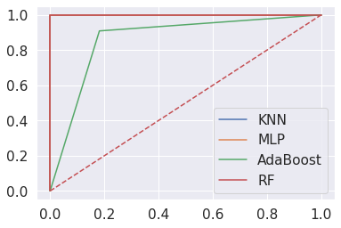
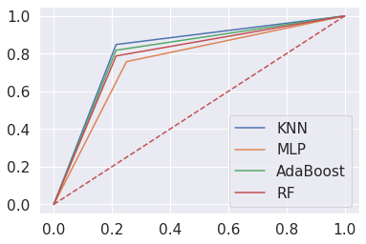
ROC curve Analysis
ROC curve for traindata
ROC curve for test data
ROC curves display the performance of a classification model.The greater the AUC for the ROC Curve, the better the performance. We can see from the constructed curves that the KNN has the highest AUC, indicating that it is the best model for this classifier.
05

Slide 25
06
Future Work and Conclusion

Slide 26
Future Work and Conclusion
Future Works
Conclusion
My experiment produced good results, but the accuracy may be increased by testing with more data and more sophisticated ways. Using several models can also assist to enhance performance.
The heart attack possibility performance is shown in this research analysis. The performance analysis identified several categories, including confusion metrics, precision, recall,f measure, and auc. In terms of overall performance, KNN outperforms the others, with an accuracy of 82%. To determine the best performance from our dataset, some machine learning techniques are used. In the future, this study will incorporate deep learning and artificial intelligence methods to analyze and predict the possibility of a heart attack. I also added more information as needed.
06

Slide 27
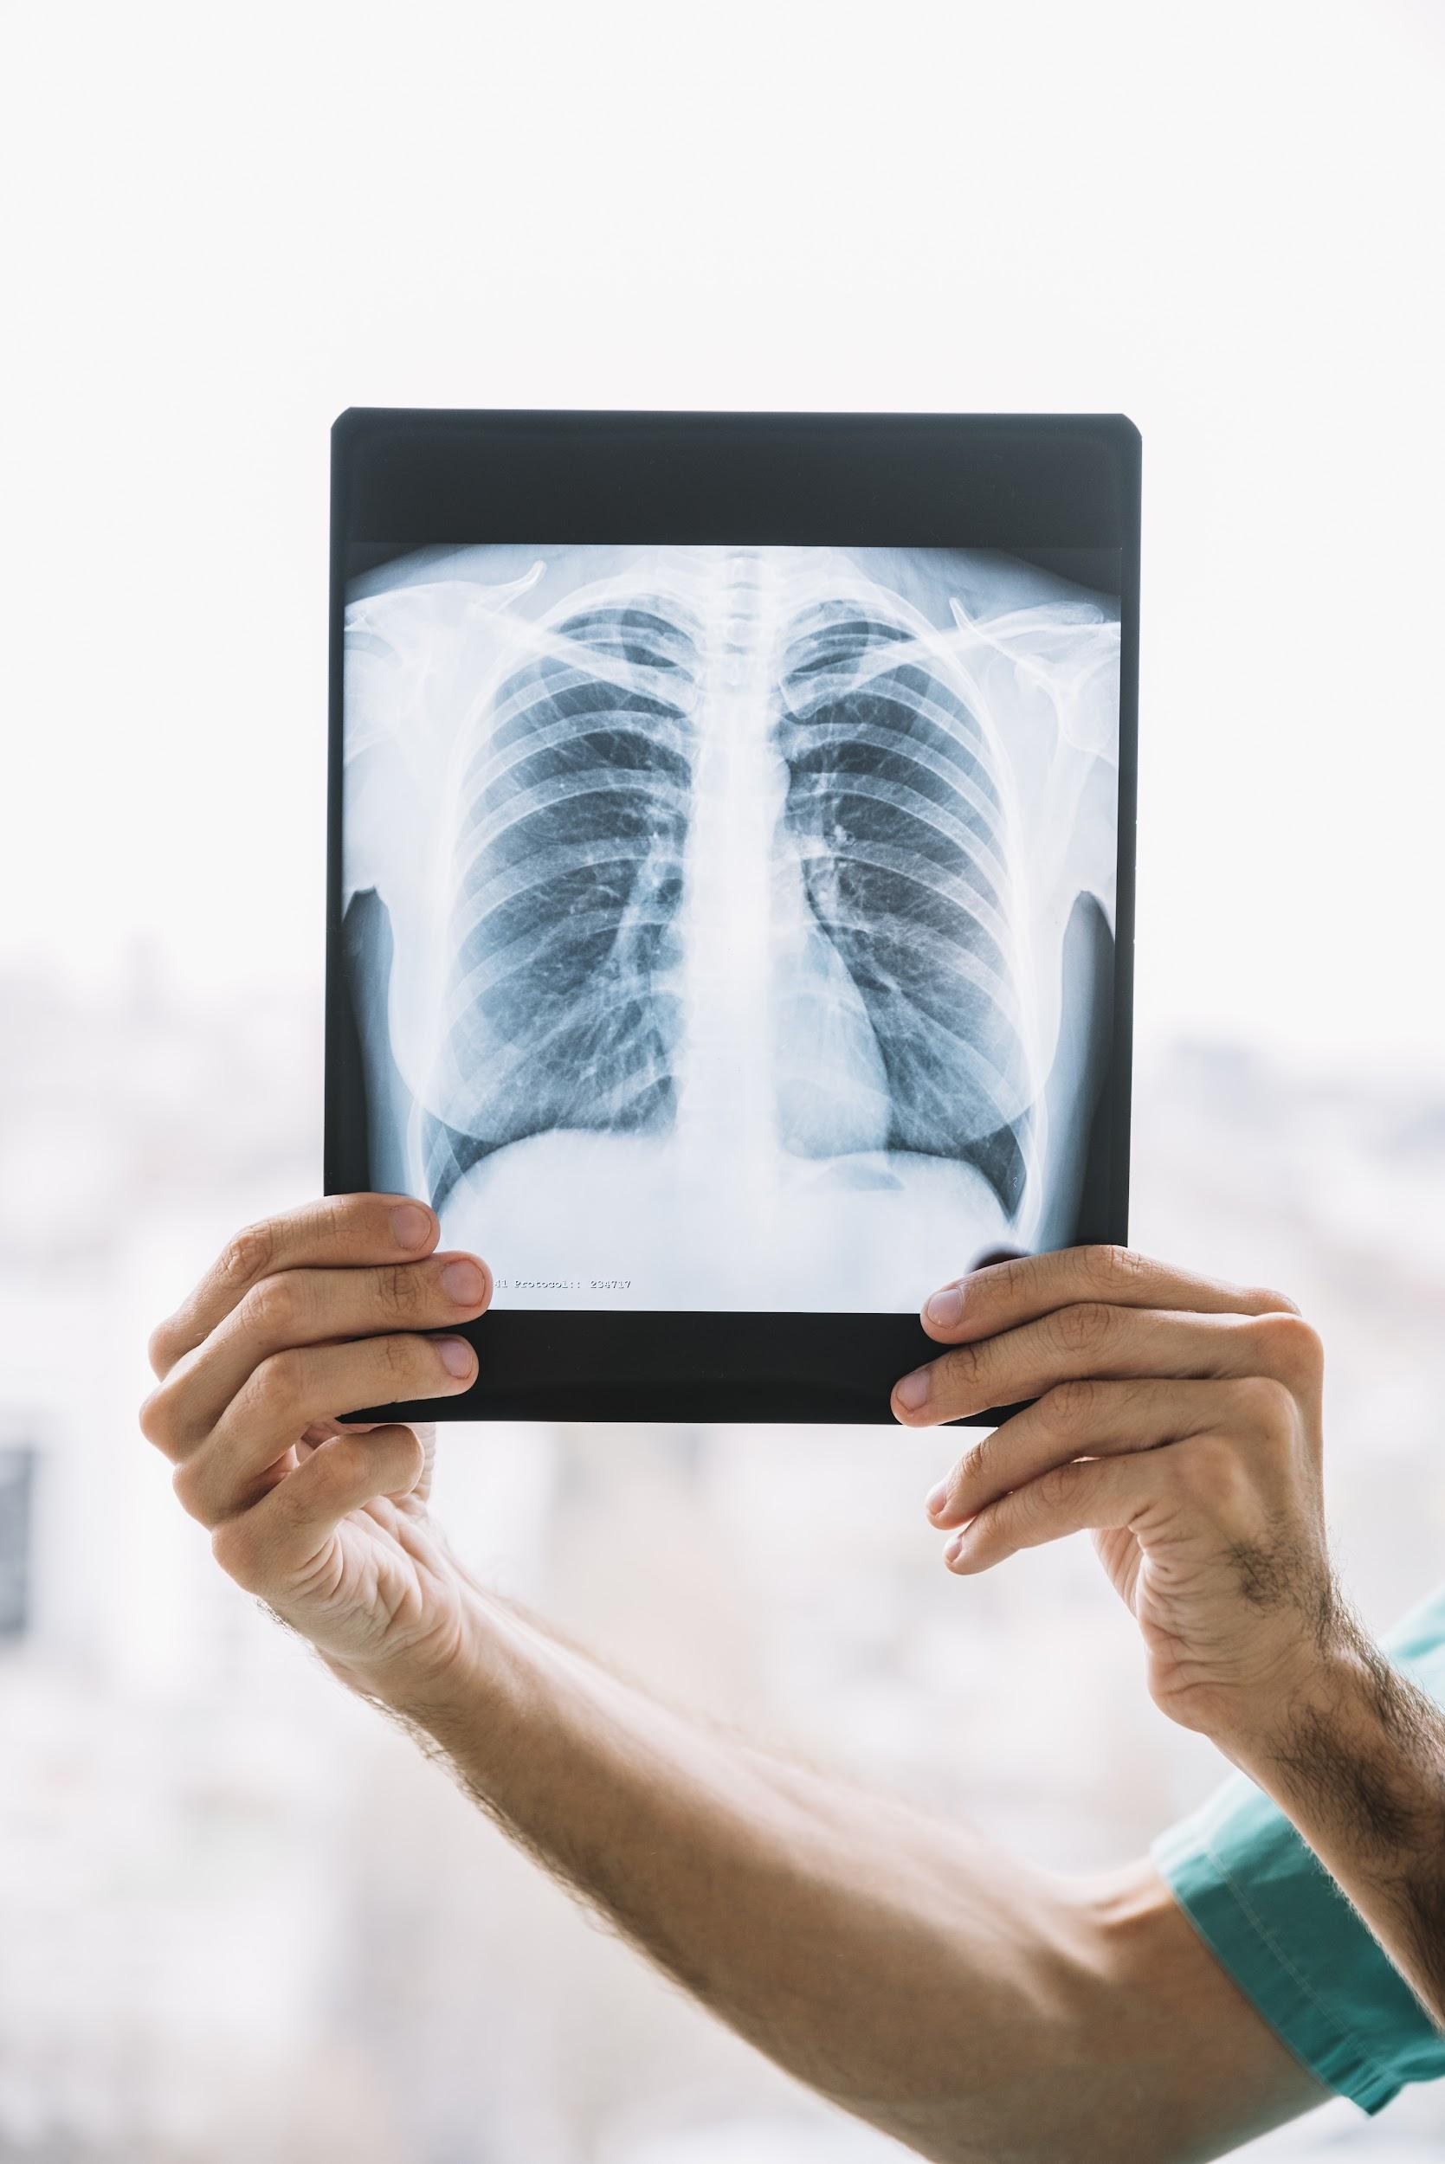
References
W. B. Kannel, “Contribution of the framingham study to preventive cardiology,” Journal of the American College of Cardiology, vol. 15, no. 1, pp. 206–211, 1990.
A. Rajkumar and G. S. Reena, “Diagnosis of heart disease using data mining algorithm,” Global journal of computer science and technology, vol. 10, no. 10, pp. 38–43, 2010.
S. S. Mahmood, D. Levy, R. S. Vasan, and T. J. Wang, “The framingham heart study and the epidemiology of cardiovascular disease: a historical perspective,” The lancet, vol. 383, no. 9921, pp. 999–1008, 2014.
F. Ahmed, “An internet of things (iot) application for predicting the quantity of future heart attack patients,” International Journal of Computer Applications, vol. 164, no. 6,pp. 36–40, 2017.
A. Methaila, P. Kansal, H. Arya, P. Kumar, et al., “Early heart disease prediction using data mining techniques,” Computer Science & Information Technology Journal, vol. 28,pp. 53–59, 2014.
“Heart disease data set.” https://archive.ics.uci.edu/ml/datasets/Heart+Disease. Accessed: 2022-08-15.

Slide 28
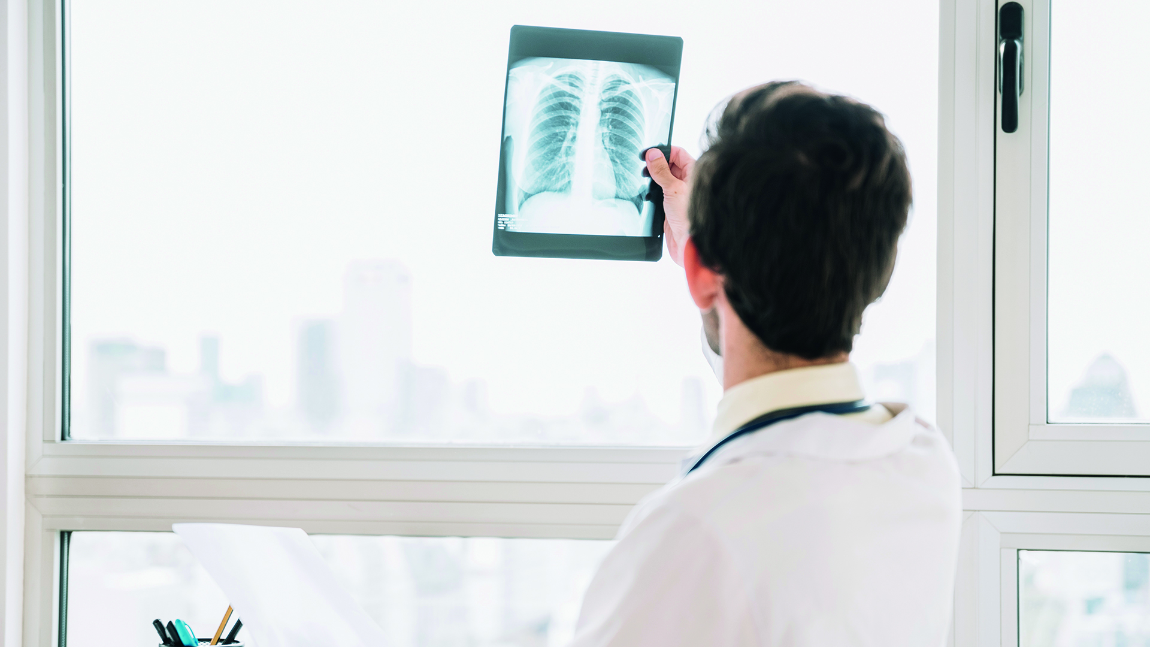
THANK YOU!

